Slide 1
Booth Fickett School Title I Program Home of the Falcons
Annual Title I Parent Meeting
Date 09/15/22

Slide 2
Has been allocated
$299,250
in Federal Title I dollars for 2022-2023 School Year.

Slide 3
What is the purpose of Title 1

Slide 4
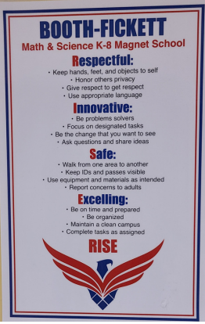
The purpose of Title I is to ensure that all students …
…receive a high-quality education
…from appropriately certified, well-trained staff
…who use evidence-based instructional methods.

Slide 5
Title I Funds are for…
supporting struggling learners with additional resources and help in reading and mathematics.

Slide 6
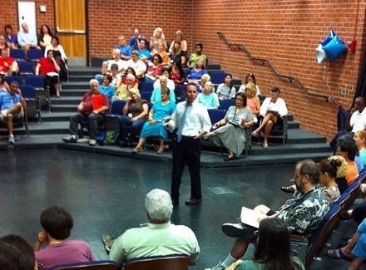
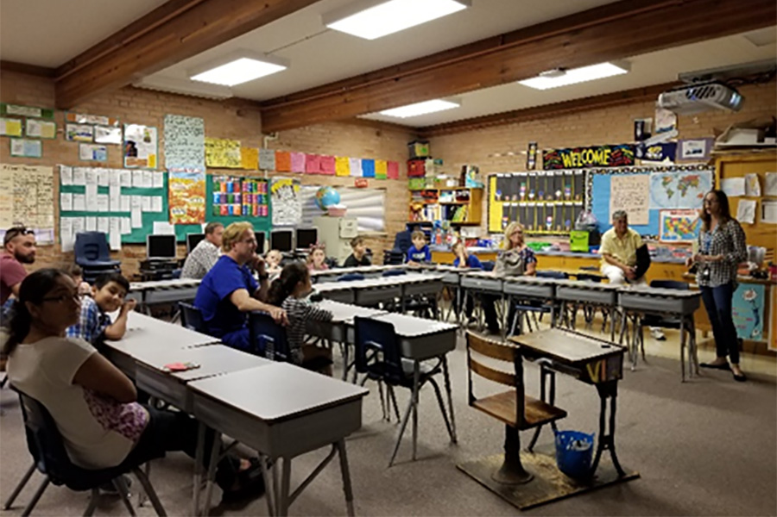
Title I funds help our school offer families:
interactive learning opportunities
TO
support student achievement at high academic levels

Slide 7
Arizona’s Academic Standards Assessment (AASA)
Reading-ELA
Grade 3 | 33%
Grade 4 | 15%
Grade 5 | 18%
Grade 6 | 14%
Grade 7 | 13%
Grade 8 | 17%
Math
Grade 3 | 35%
Grade 4 | 11%
Grade 5 | 16%
Grade 6 | 4%
Grade 7 | 6%
Grade 8 | 6%
*Percent of students passing

Slide 8
School Letter Grade
The Arizona Department of Education (ADE) assigns each school a letter grade based on spring 2022 Arizona’s Academic Standards Assessment results. When the information is received, we will notify our community.
School grades are based on:
The percentage of students who passed the Arizona’s Academic Standards Assessment (AASA) exam.
The percentage of students who attained academic growth reaching or exceeding grade level expectations.
Additional factors such as the percentage of students evaluated, graduation rate-High School Only, reclassification of English language students.
Title I funds help our school maintain / improve our school score by improving student achievement through the strategic use of federal funds.

Slide 9
Improvement Goals -
Booth Fickett will provide professional development to teachers to increase the use of effective DOK questioning
PLT teachers will collaborate to address exceptional ED students. Through this collaboration, classroom management needs will be addressed
Structured PLT time for teachers- A curriculum PLT will be held at least monthly, to review district required TUSD standards

Slide 10
Booth Fickett will develop and implement a campus wide program for providing Social/Emotional Learning that is embedded into the master schedule
Universal Screening to Support Interventions/Enrichment - Booth Fickett will develop a universal screener in ELA, Math, and Science in order to generate current and timely information of student needs.
Teacher PD geared toward data analysis -CSP working with small groups PD, lesson plan analysis.
Increasing tier 1 instruction - use researched base curriculum. expectations using scope and sequence curriculum, teachers utilizing curriculum maps for the year.

Slide 11
Thank you for attending your school's annual Title 1 Meeting
Your tax dollars are being put to work at Booth Fickett K-8 School.

